Slide 1
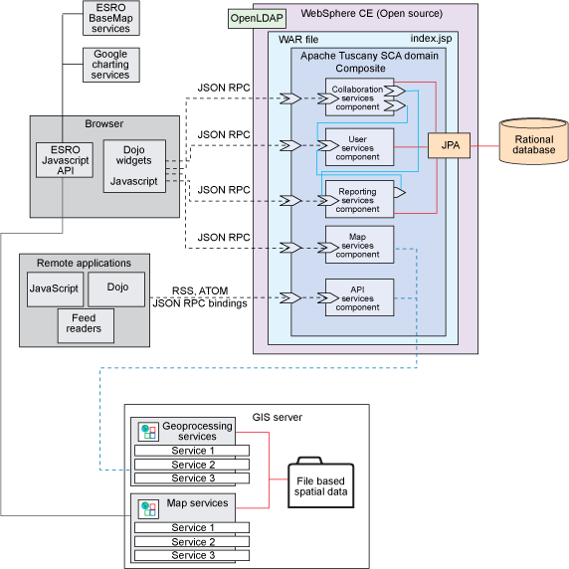

Slide 2
API
Security
TX
Command API
Other APIs
Services
Spatial
Non-spatial
Domain
POJO
Persistence
Hibernate
Spatial
database

Slide 3

Dojo Face
GWT Face
???
Rendered Feature
Raster Image
???
Server API
Feature command
Raster Command
Geoprocessing Command
???
Application
Map
VectorLayer
RasterLayer
Geotools LayerModel
Hibernate LayerModel
Custom LayerModel
Google Layer
WMS Layer
???
Feature
POJO
???
OGC/other Services
Spatial DB

Slide 4
Geomajas
Custom extension
backend
backend api
backend api
Custom layer model
backend api
backend api
backend api
Custom face
dojo face server
GWT face server
server
face
internal
face
internal
client
dojo face client
GWT face client
dojo
face api
GWT
face api
dojo app
GWT app

Slide 5
backend
Command X
Command Z
Command Y
5
execute command
Get response, handle exceptions
CommandDispatcher
4
GeoSecurityManager
6
Check security
CommandResponse
For display, these are typically Tile instances,
Which contain
the Features to render (if any)
a link to a (raster) image
Command name,
CommandRequest,
User token
CommandRequest
CommandRequest
3
7
serialized
Face server
2
CommandRequest
face client
CommandResponse
8
1
serialized

Slide 6
Geomajas backend
Geomajas-api
command
…
Geomajas-impl
rendering
strategy
…
security
…
layer model
…
caching
strategy …

Slide 7
Getting a RenderedTile
Getting the tile image
VectorRendering
cache
broker
Paint layer
TileImageCreator
FeaturePainter
get data
TilePainter paint
call painters

Slide 8
SecurityManager
Authentication mechanism
(for example SSO server)
Security Services
Security Service
Policy store
(for example PERMIS)
…
SecurityContext
UserInfo
Authentication
…

